Slide 2
Use Case Driven Development
Design Methodology
  Agile, similar to RUP
  Use cases Are the main feature of our development process
  Everything ties up to a use cases
    Directly – features requested by the client
    Indirectly – documentation, unit tests, etc.

Slide 3
Use Case Driven Development continued
Goals
  Standardised documentation
    All use cases are derived from a standard template and follow set naming conventions
  Compartmentalised files
    Use cases are stored in separated files providing better support for concurrent modification, easy referencing and versioning
  Versioning to manage changes in requirements
    Versions are tracked as separate sheets within each use case’s file.

Slide 4
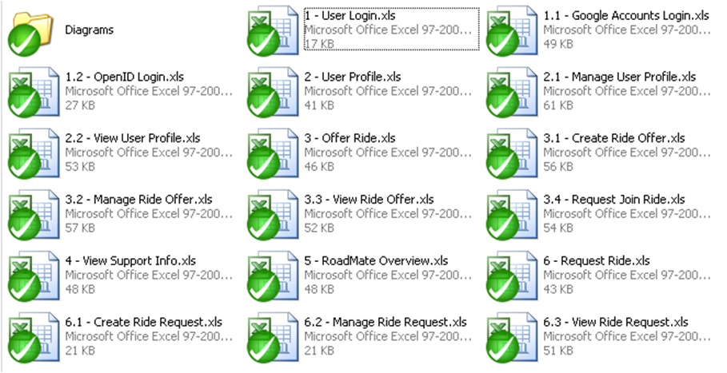
Use Case Driven Development continued
Example of Current Usecases

Slide 5
Online Project Management Tool
Google Code’s issue tracking system
  Customised to serve as an online project management tool
  Used for:
    Issue Tracking
    Feature Management
    Overall Progress Evaluation

Slide 6
Issue Tracking
  Issues are tracked in traditional way
  Strong emphasis placed on providing clear summaries, appropriate tags, and tying issues to the revision.
  When a test case fails it is immediately recorded in the issue tracking system with a back reference to the test case.

Slide 7
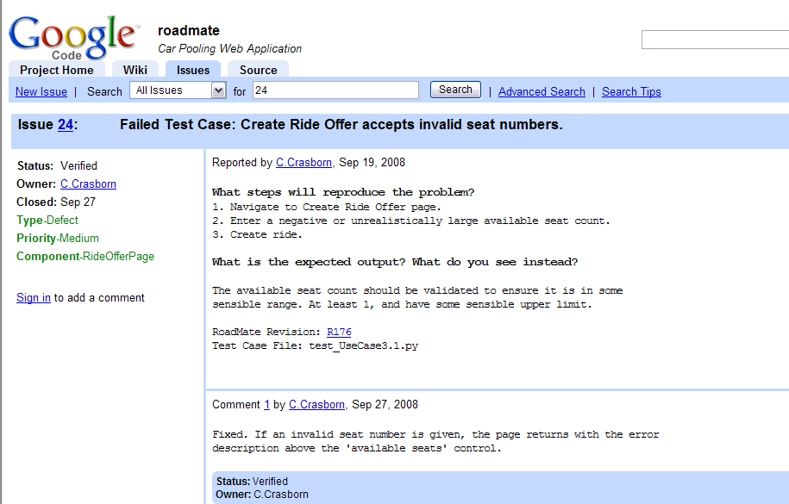
Issue Tracking Example

Slide 8
Feature Management
  Features are tagged with the site component they belong to and milestone we expect to have them completed by.
  We are able to automatically generate current and expected feature sets using the issue tracking system.

Slide 9
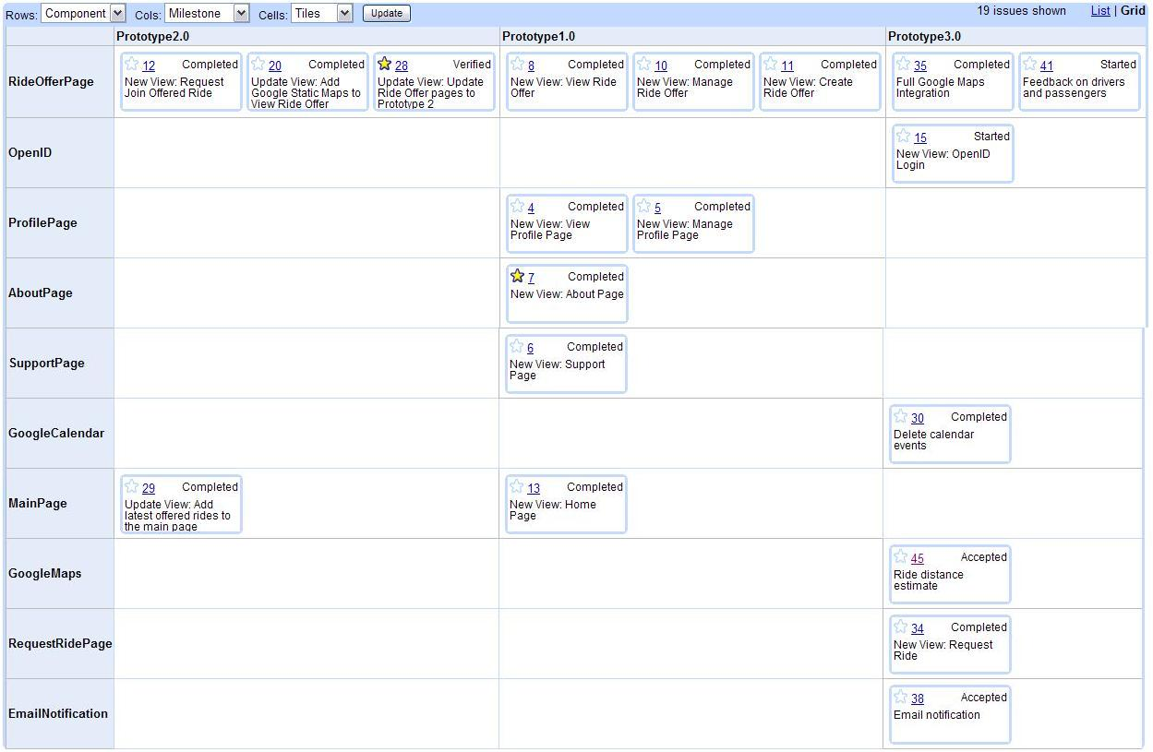
Feature Management example

Slide 10
Queued Features
By Priority:
  OpenID Support
  Multi-Stop rides
  Changing specified location by clicking on Google map
  RSS Feeds
  User Groups
  Ride Options
  Printer Friendly Views
  In-site Notifications
  Friends System
  Events
  Google Ads
  User Administration Features
  User Avatar/Icons

Slide 11
Implementation
  Google App Engine
  Python Runtime
  Datastore API
  Django
  Java Script
  AJAX

Slide 12
Google App Engine Features
  dynamic web serving, with full support for common web technologies
  persistent storage with queries, sorting and transactions
  automatic scaling and load balancing
  APIs for authenticating users and sending email using Google Accounts
  a fully featured local development environment that simulates Google App Engine on your computer
  includes a service API for integrating with Google Accounts

Slide 13
Datastore API
  Uses optimistic locking for concurrency control.
  Data objects, or "entities," have a kind and a set of properties.
  Queries can retrieve entities of a given kind filtered and sorted by the values of the properties.
  Application can execute multiple datastore operations in a single transaction (either all fail or all succeed to ensure integrity).
  transactions implemented across distributed network using "entity groups."

